Slide 1
DETERMINANT
MATH 15 - Linear Algebra

Slide 2
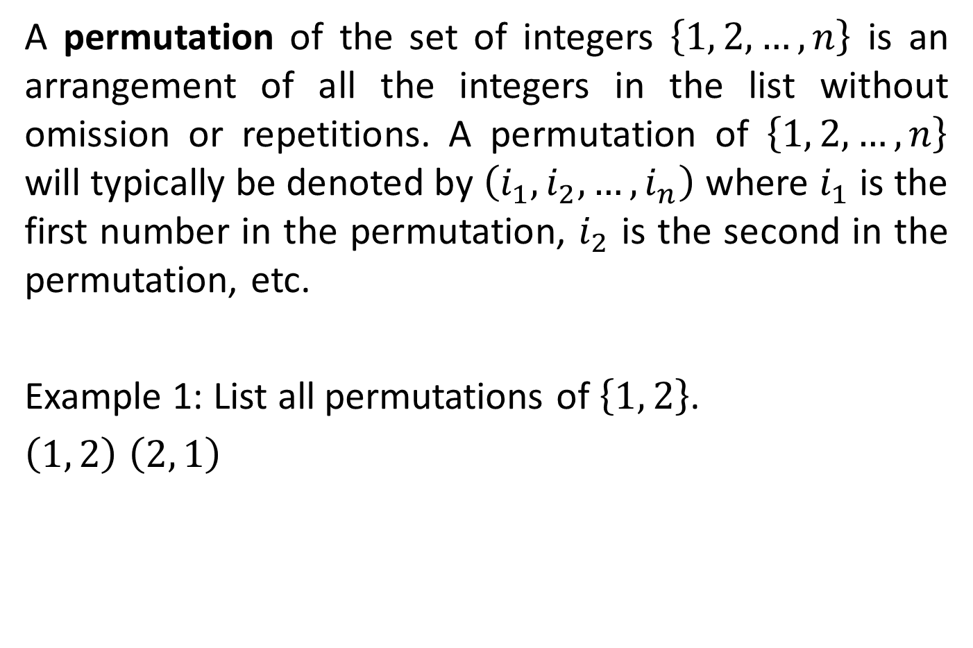
PERMUTATION
A permutation of the set of integers $\left\{1, 2,…,n\right\}$ is an arrangement of all the integers in the list without omission or repetitions. A permutation of $\left\{1, 2,…,n\right\}$ will typically be denoted by $\left(i_{1},i_{2},…,i_{n}\right)$ where $i_{1}$ is the first number in the permutation, $i_{2}$ is the second in the permutation, etc.
Example 1: List all permutations of $\left\{1, 2\right\}$.
$\left(1, 2\right)$ $\left(2, 1\right)$

Slide 3

PERMUTATION
Example 2: List all permutations of $\left\{1, 2, 3\right\}$.
$$\left(1, 2, 3\right) \left(1, 3, 2\right) \left(2, 1, 3\right) \left(2, 3, 1\right) \left(3, 1, 2\right) \left(3, 2, 1\right)$$
Generally, from $\left\{1, 2,…,n\right\}$, there are $n!$ Permutations.

Slide 4
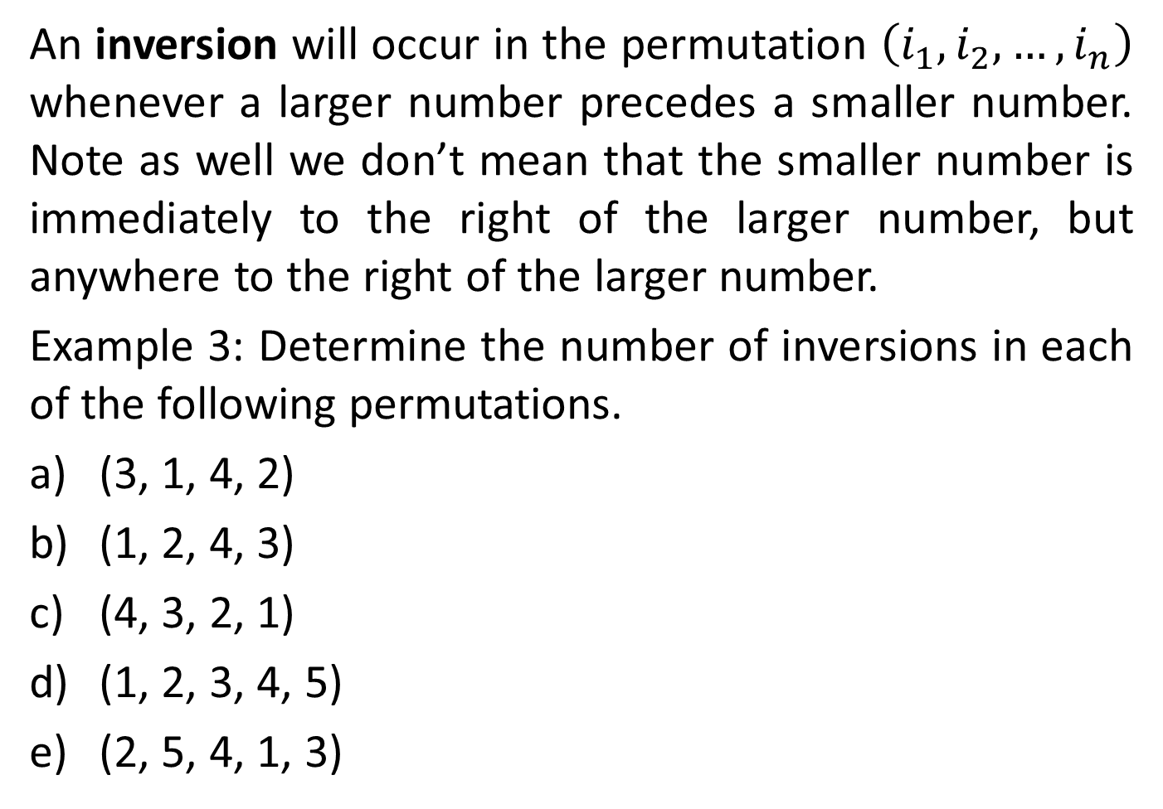
INVERSION
An inversion will occur in the permutation $\left(i_{1}, i_{2},…,i_{n}\right)$ whenever a larger number precedes a smaller number. Note as well we don’t mean that the smaller number is immediately to the right of the larger number, but anywhere to the right of the larger number.
Example 3: Determine the number of inversions in each of the following permutations.
(3, 1, 4, 2)
(1, 2, 4, 3)
(4, 3, 2, 1)
(1, 2, 3, 4, 5)
(2, 5, 4, 1, 3)

Slide 5
INVERSION
Solution:
(3, 1, 4, 2)
We will start at the left most number and count the number of numbers to the right that are smaller. We then move to the second number and do the same thing. We continue in this manner until we get to the end. The total number of inversions are then the sum of all these.
(3, 1, 4, 2) 2 inversions
(3, 1, 4, 2) 0 inversions
(3, 1, 4, 2) 1 inversion
The permutation (3, 1, 4, 2) has a total of 3 inversions.

Slide 6
INVERSION
(1, 2, 4, 3)
0 + 0 + 1 =1 inversion
(4, 3, 2, 1)
3 + 2 + 1 = 6 inversions
(1, 2, 3, 4, 5)
No inversions
(2, 5, 4, 1, 3)
1 + 3 + 2 + 0 = 6 inversions

Slide 7
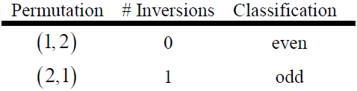
PERMUTATION
A permutation is called even if the number of inversions is even and odd if the number of inversions is odd.
Example 4: Classify as even or odd all the permutations of the following lists.
{1, 2}
{1, 2, 3}
Solution:

Slide 8
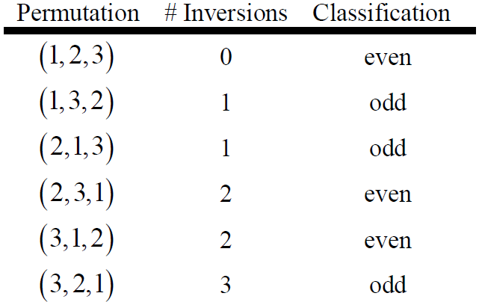
PERMUTATION

Slide 9
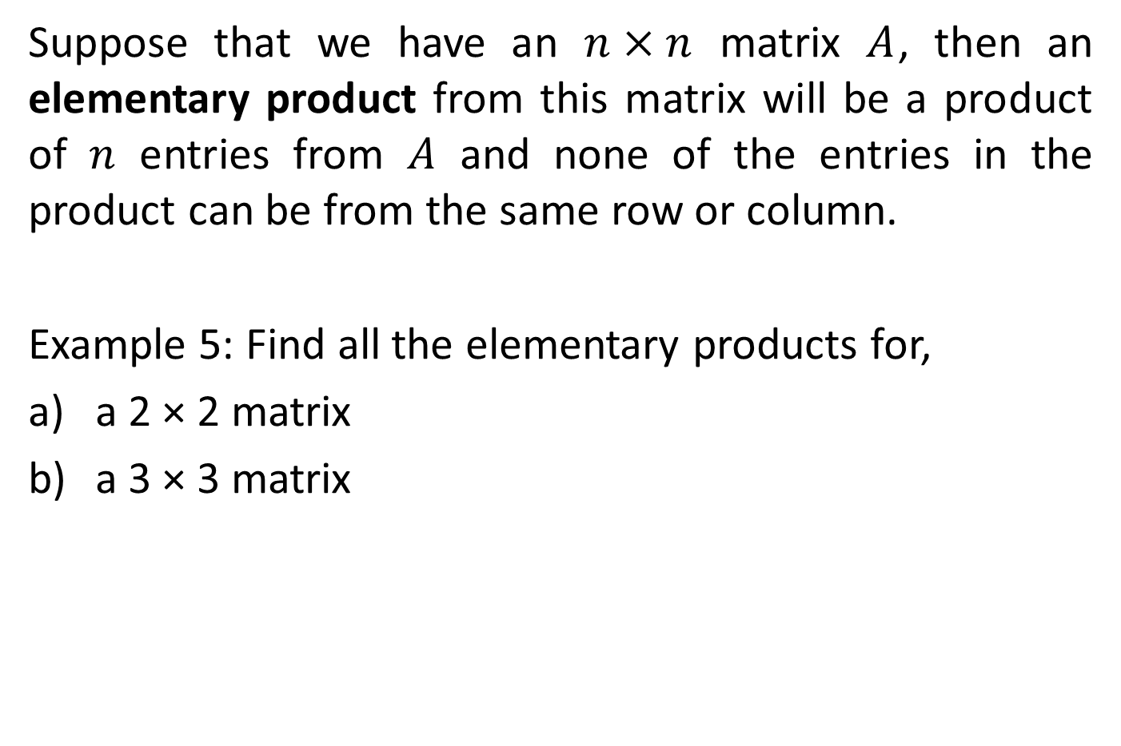
ELEMENTARY PRODUCT
Suppose that we have an $n×n$ matrix $A$, then an elementary product from this matrix will be a product of $n$ entries from $A$ and none of the entries in the product can be from the same row or column.
Example 5: Find all the elementary products for,
a 2 × 2 matrix
a 3 × 3 matrix

Slide 10
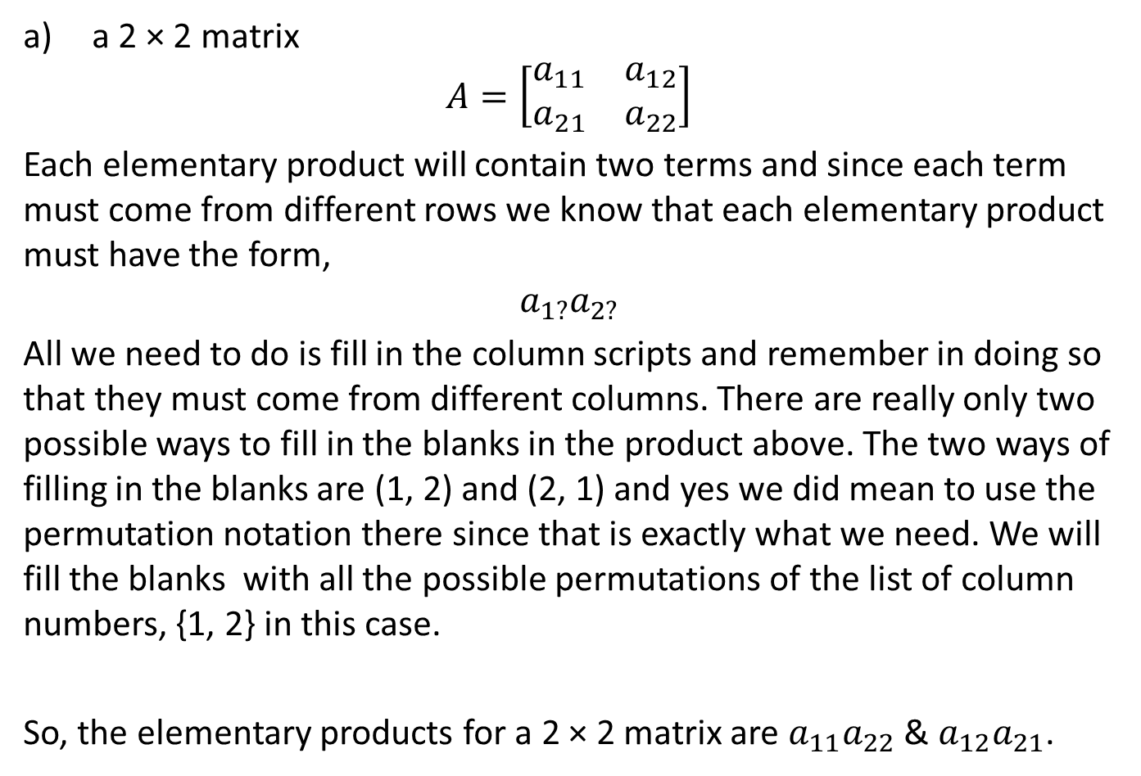
ELEMENTARY PRODUCT
a 2 × 2 matrix
$$A=\left[\begin{matrix}a_{11} & a_{12} \\ a_{21} & a_{22}\end{matrix}\right]$$
Each elementary product will contain two terms and since each term must come from different rows we know that each elementary product must have the form,
$$a_{1?}a_{2?}$$
All we need to do is fill in the column scripts and remember in doing so that they must come from different columns. There are really only two possible ways to fill in the blanks in the product above. The two ways of filling in the blanks are (1, 2) and (2, 1) and yes we did mean to use the permutation notation there since that is exactly what we need. We will fill the blanks with all the possible permutations of the list of column numbers, {1, 2} in this case.
So, the elementary products for a 2 × 2 matrix are $a_{11}a_{22}$ & $a_{12}a_{21}$.

Slide 11
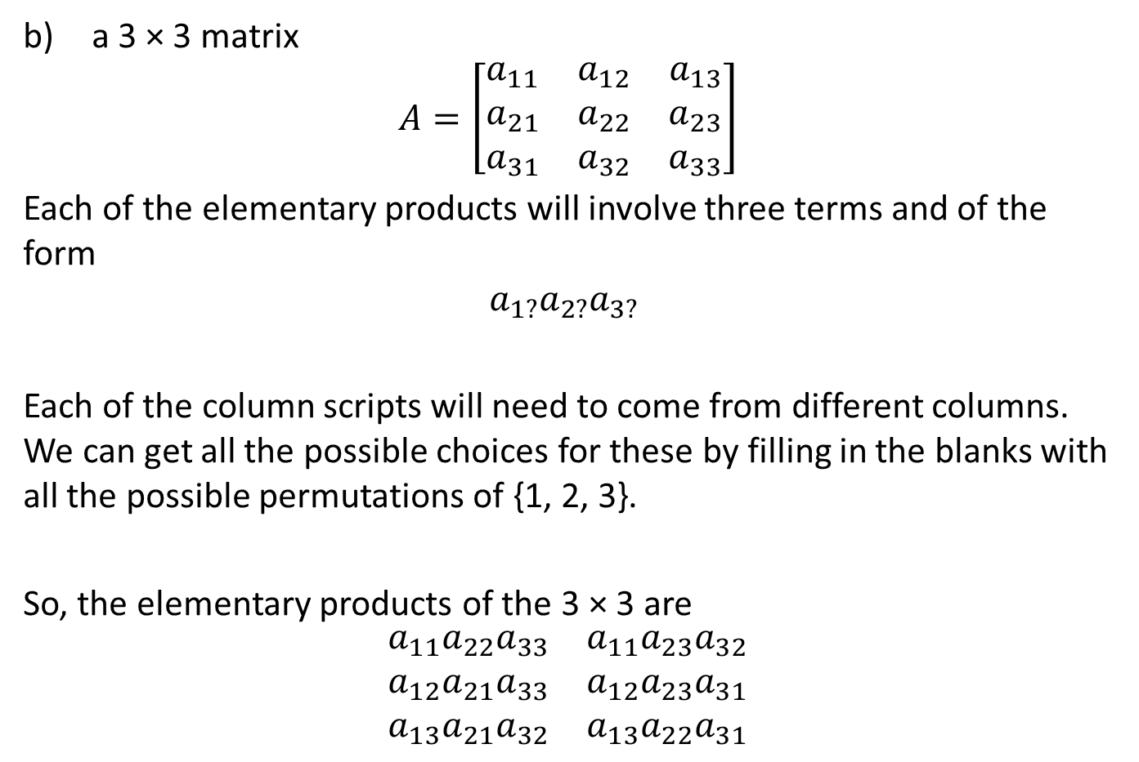
ELEMENTARY PRODUCT
a 3 × 3 matrix
$$A=\left[\begin{matrix}a_{11} & a_{12} & a_{13} \\ a_{21} & a_{22} & a_{23} \\ a_{31} & a_{32} & a_{33}\end{matrix}\right]$$
Each of the elementary products will involve three terms and of the form
$$a_{1?}a_{2?}a_{3?}$$
Each of the column scripts will need to come from different columns. We can get all the possible choices for these by filling in the blanks with all the possible permutations of {1, 2, 3}.
So, the elementary products of the 3 × 3 are
$$\begin{matrix}a_{11}a_{22}a_{33} & a_{11}a_{23}a_{32} \\ a_{12}a_{21}a_{33} & a_{12}a_{23}a_{31} \\ a_{13}a_{21}a_{32} & a_{13}a_{22}a_{31}\end{matrix}$$

Slide 12
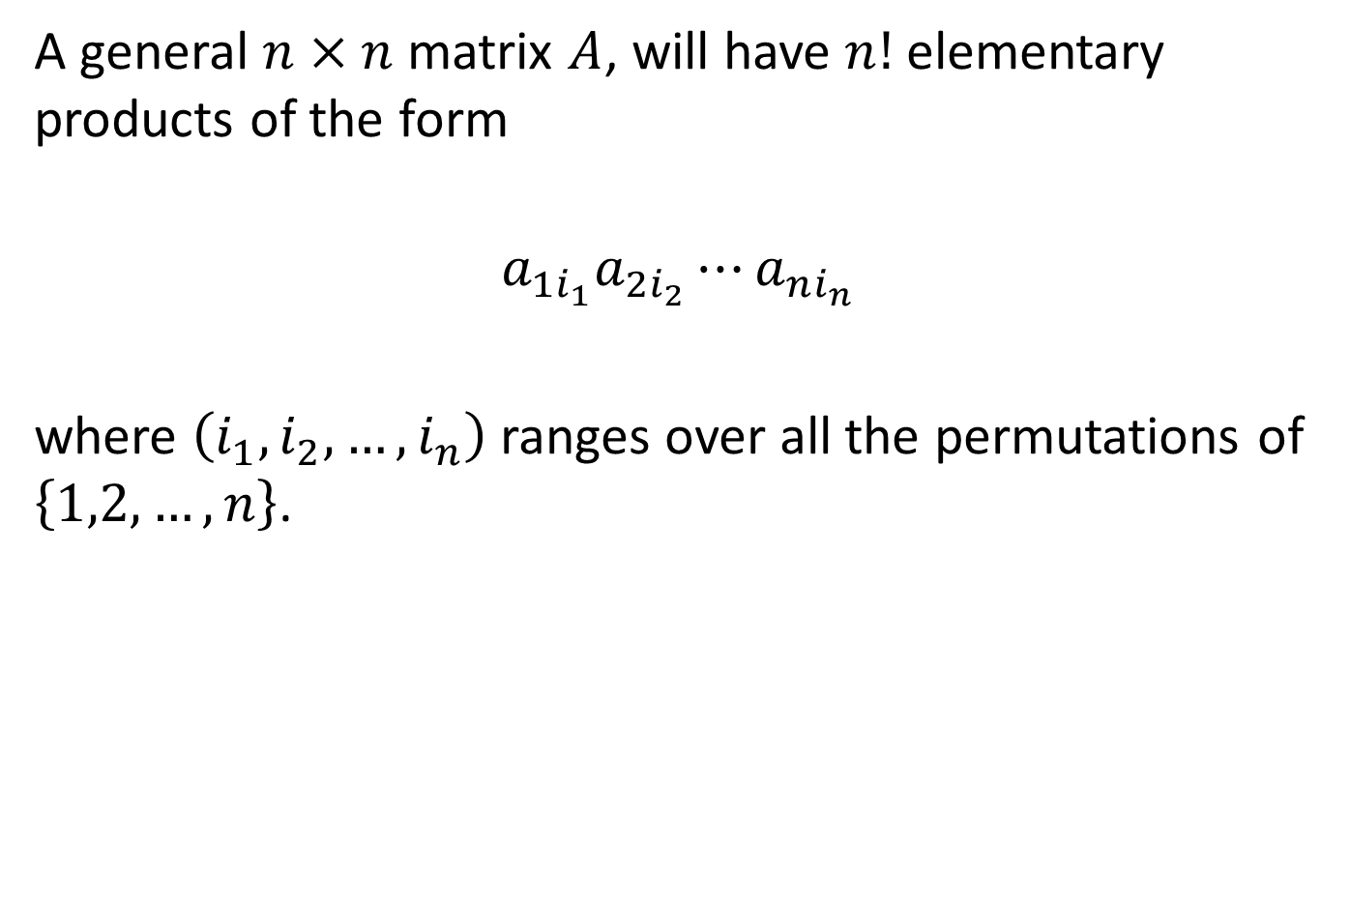
ELEMENTARY PRODUCT
A general $n×n$ matrix $A$, will have $n!$ elementary products of the form
$$a_{1i_{1}}a_{2i_{2}}⋯a_{ni_{n}}$$
where $\left(i_{1},i_{2},…,i_{n}\right)$ ranges over all the permutations of $\left\{1,2,…,n\right\}$.

Slide 13
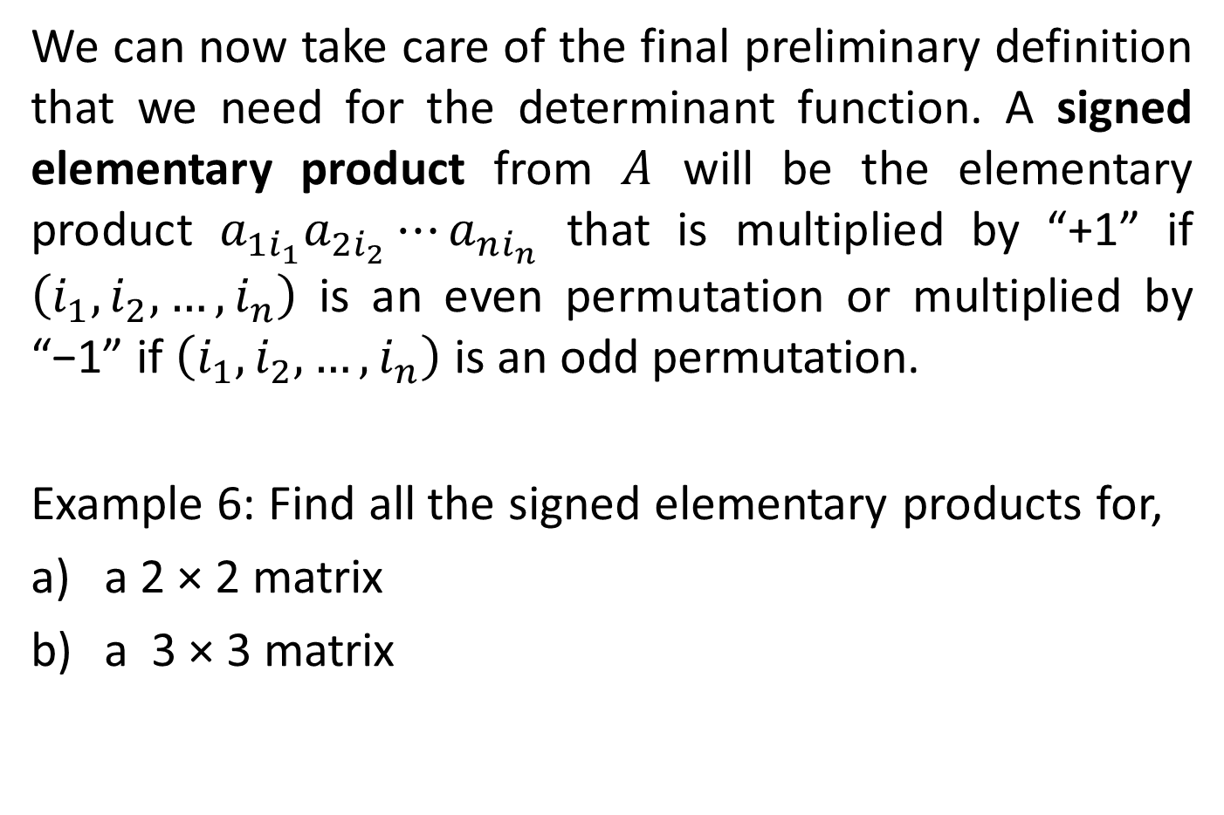
SIGNED ELEMENTARY PRODUCT
We can now take care of the final preliminary definition that we need for the determinant function. A signed elementary product from $A$ will be the elementary product $a_{1i_{1}}a_{2i_{2}}⋯a_{ni_{n}}$ that is multiplied by “+1” if $\left(i_{1},i_{2},…,i_{n}\right)$ is an even permutation or multiplied by “−1” if $\left(i_{1},i_{2},…,i_{n}\right)$ is an odd permutation.
Example 6: Find all the signed elementary products for,
a 2 × 2 matrix
a 3 × 3 matrix

Slide 14
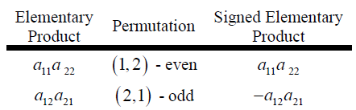
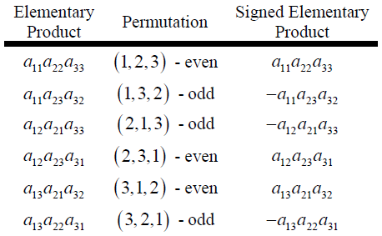
SIGNED ELEMENTARY PRODUCT
Solution:

Slide 15
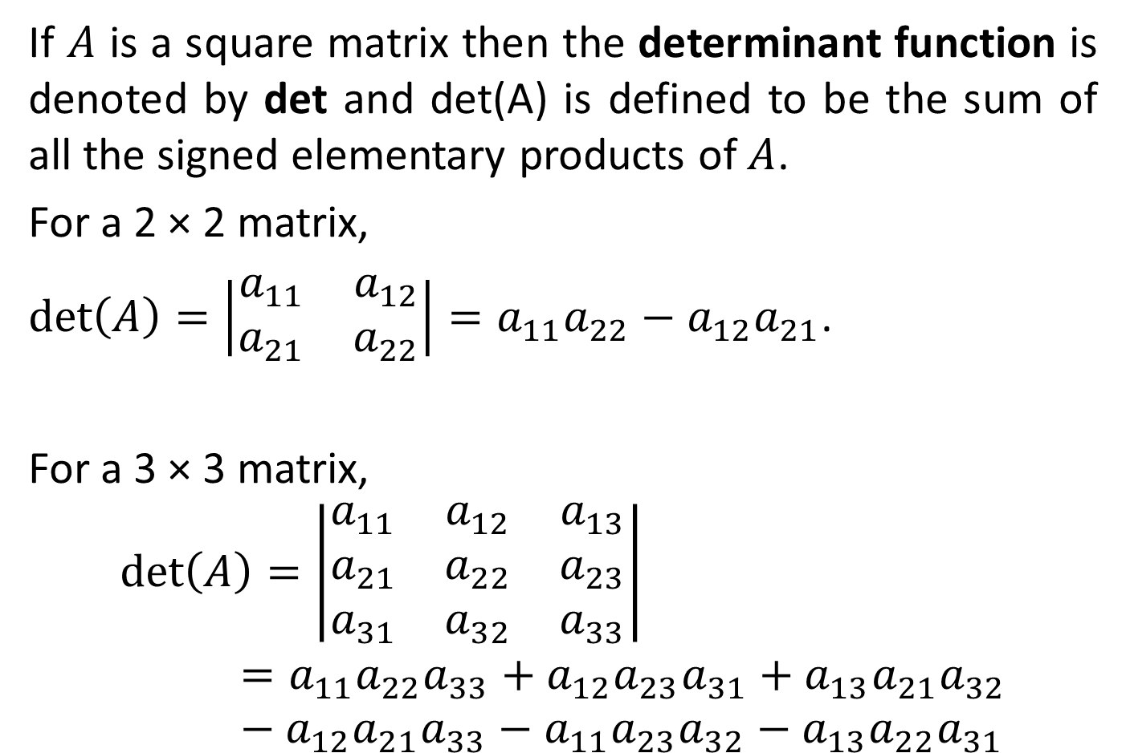
DEFINITION 1
If $A$ is a square matrix then the determinant function is denoted by det and det(A) is defined to be the sum of all the signed elementary products of $A$.
For a 2 × 2 matrix,
$det\left(A\right)=\left|\begin{matrix}a_{11} & a_{12} \\ a_{21} & a_{22}\end{matrix}\right|=a_{11}a_{22}−a_{12}a_{21}$.
For a 3 × 3 matrix,
$$det\left(A\right)=\left|\begin{matrix}a_{11} & a_{12} & a_{13} \\ a_{21} & a_{22} & a_{23} \\ a_{31} & a_{32} & a_{33}\end{matrix}\right|=a_{11}a_{22}a_{33}+a_{12}a_{23}a_{31}+a_{13}a_{21}a_{32}−a_{12}a_{21}a_{33}−a_{11}a_{23}a_{32}−a_{13}a_{22}a_{31}$$

Slide 16
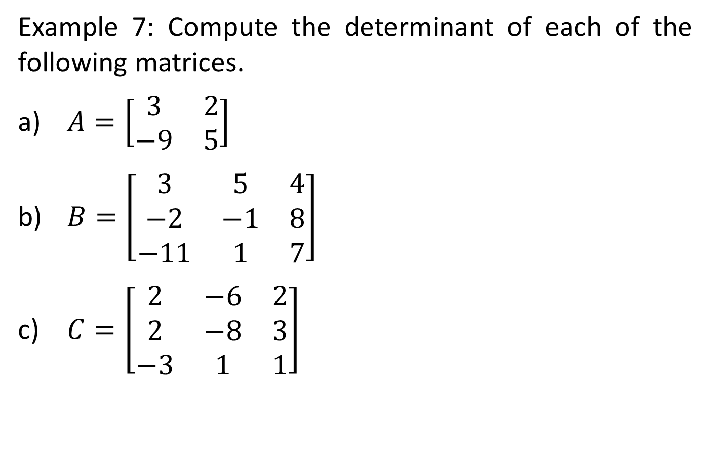
DETERMINANT
Example 7: Compute the determinant of each of the following matrices.
$A=\left[\begin{matrix}3 & 2 \\ −9 & 5\end{matrix}\right]$
$B=\left[\begin{matrix}3 & 5 & 4 \\ −2 & −1 & 8 \\ −11 & 1 & 7\end{matrix}\right]$
$C=\left[\begin{matrix}2 & −6 & 2 \\ 2 & −8 & 3 \\ −3 & 1 & 1\end{matrix}\right]$

Slide 17
PROPERTIES OF DETERMINANTS
For all square matrices, the following properties hold:
If a row or a column of a given matrix is a multiple or equal to another row or column, then the determinant is equal to 0.
If a row or a column of a matrix consists entirely of zeroes, then its determinant is equal to zero.
The determinant of a matrix is equal to the determinant of its transpose.
When matrix multiplication is possible, the product of the determinants of the given matrices is equal to the determinant of the product.

Slide 18
PROPERTIES OF DETERMINANTS
For all square matrices, the following properties hold:
Interchanging two rows or two columns will make the determinant negative.
Constants can be factored from a single row or column of a matrix.
Adding a multiple of another row to a given matrix would not change the determinant of the matrix.
The determinant of a triangular matrix is the product of its diagonal elements.

Slide 19
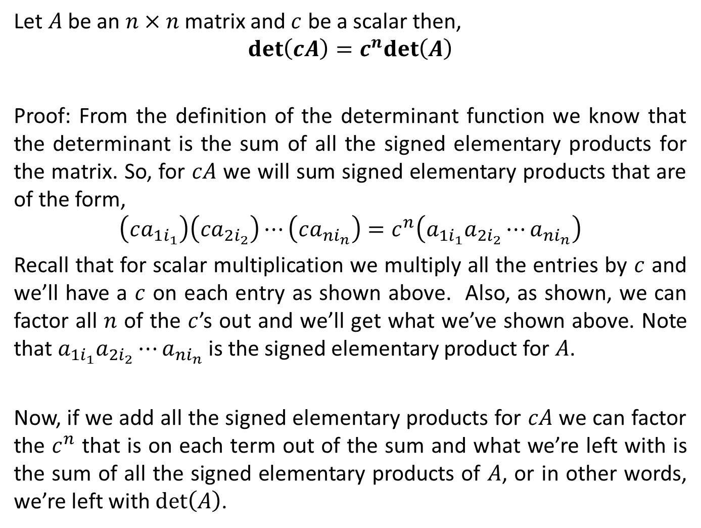
THEOREM 1
Let $A$ be an $n×n$ matrix and $c$ be a scalar then,
$$det\left(cA\right)=c^{n}det\left(A\right)$$
Proof: From the definition of the determinant function we know that the determinant is the sum of all the signed elementary products for the matrix. So, for $cA$ we will sum signed elementary products that are of the form,
$$\left(ca_{1i_{1}}\right)\left(ca_{2i_{2}}\right)⋯\left(ca_{ni_{n}}\right)=c^{n}\left(a_{1i_{1}}a_{2i_{2}}⋯a_{ni_{n}}\right)$$
Recall that for scalar multiplication we multiply all the entries by $c$ and we’ll have a $c$ on each entry as shown above. Also, as shown, we can factor all $n$ of the $c$’s out and we’ll get what we’ve shown above. Note that $a_{1i_{1}}a_{2i_{2}}⋯a_{ni_{n}}$ is the signed elementary product for $A$.
Now, if we add all the signed elementary products for $cA$ we can factor the $c^{n}$ that is on each term out of the sum and what we’re left with is the sum of all the signed elementary products of $A$, or in other words, we’re left with $det\left(A\right)$.

Slide 20
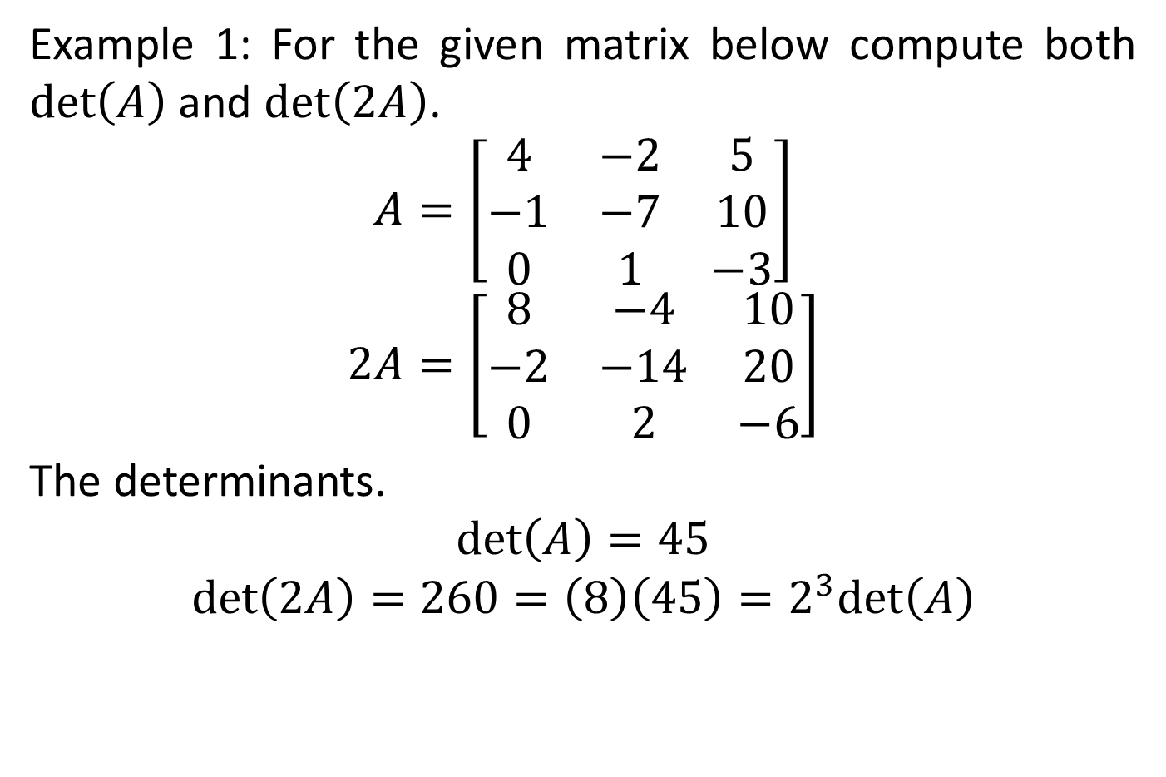
THEOREM 1
Example 1: For the given matrix below compute both $det\left(A\right)$ and $det\left(2A\right)$.
$$A=\left[\begin{matrix}4 & −2 & 5 \\ −1 & −7 & 10 \\ 0 & 1 & −3\end{matrix}\right]$$
$$2A=\left[\begin{matrix}8 & −4 & 10 \\ −2 & −14 & 20 \\ 0 & 2 & −6\end{matrix}\right]$$
The determinants.
$$det\left(A\right)=45$$
$$det\left(2A\right)=260=\left(8\right)\left(45\right)=2^{3}det\left(A\right)$$
Notes:
det(A)=45 det(2A)=360=(8)(45)=2^3*det(A)

Slide 21
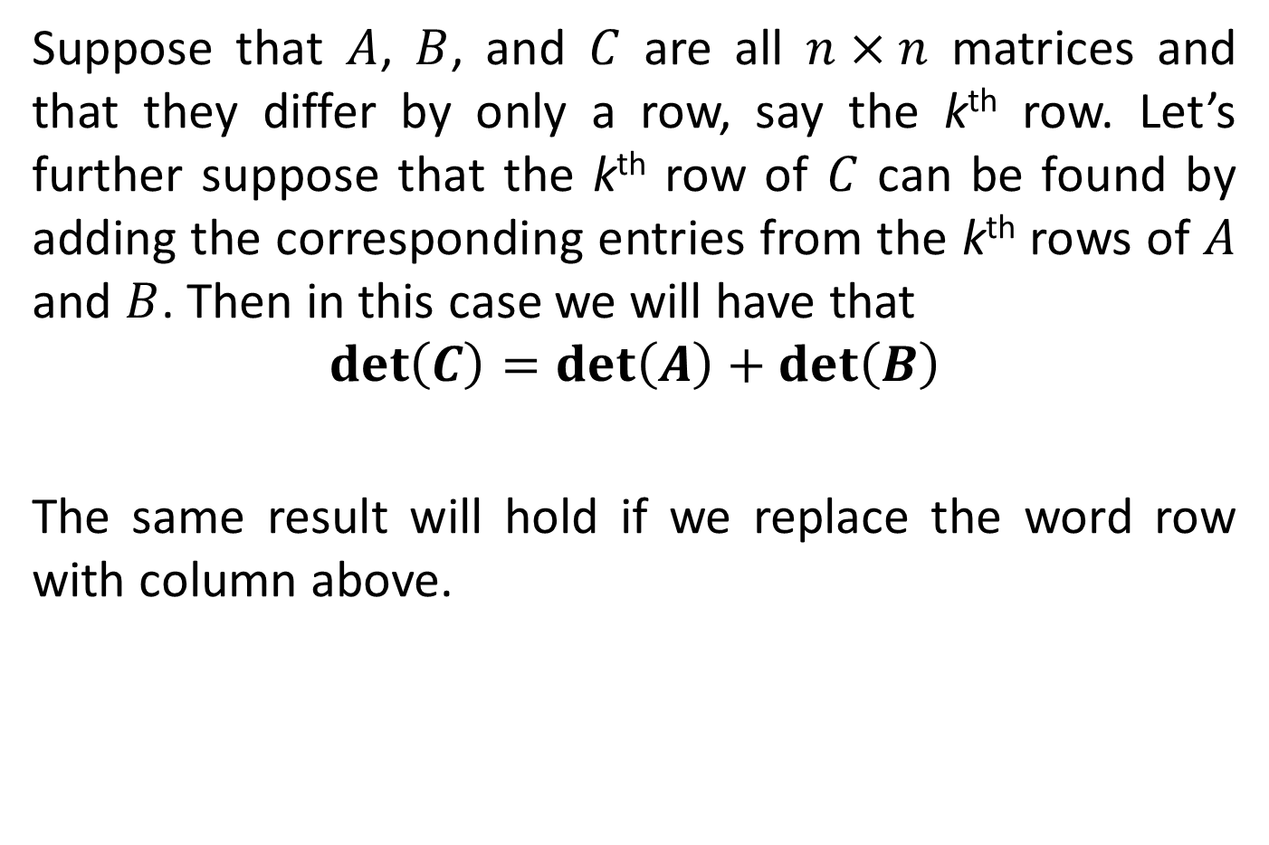
THEOREM 2
Suppose that $A$, $B$, and $C$ are all $n×n$ matrices and that they differ by only a row, say the k^{th} row. Let’s further suppose that the k^{th} row of $C$ can be found by adding the corresponding entries from the k^{th} rows of $A$ and $B$. Then in this case we will have that
$$det\left(C\right)=det\left(A\right)+det\left(B\right)$$
The same result will hold if we replace the word row with column above.

Slide 22
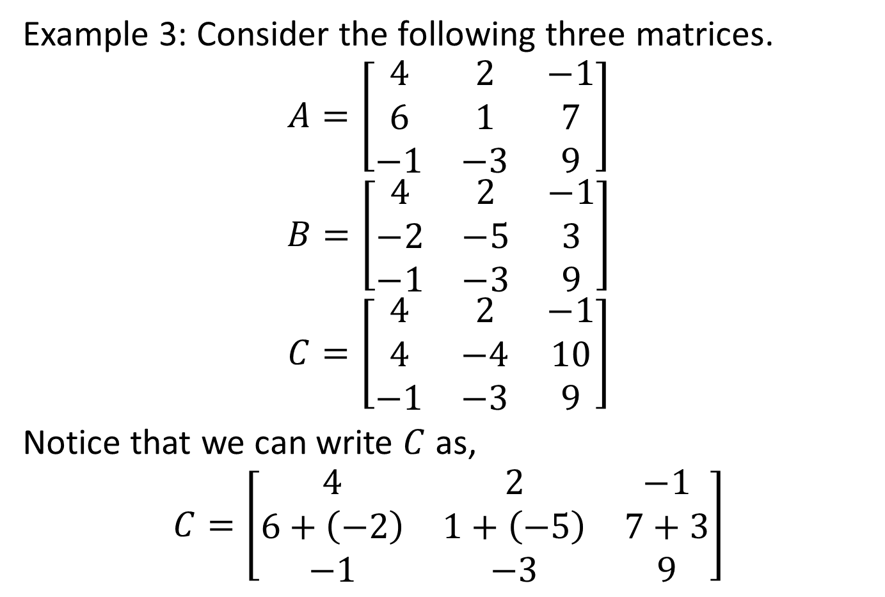
THEOREM 2
Example 3: Consider the following three matrices.
$$A=\left[\begin{matrix}4 & 2 & −1 \\ 6 & 1 & 7 \\ −1 & −3 & 9\end{matrix}\right]$$
$$B=\left[\begin{matrix}4 & 2 & −1 \\ −2 & −5 & 3 \\ −1 & −3 & 9\end{matrix}\right]$$
$$C=\left[\begin{matrix}4 & 2 & −1 \\ 4 & −4 & 10 \\ −1 & −3 & 9\end{matrix}\right]$$
Notice that we can write $C$ as,
$$C=\left[\begin{matrix}4 & 2 & −1 \\ 6+\left(−2\right) & 1+\left(−5\right) & 7+3 \\ −1 & −3 & 9\end{matrix}\right]$$

Slide 23

THEOREM 2
The determinants of these matrices are,
$$det\left(A\right)=15$$
$$det\left(B\right)=−115$$
$$det\left(C\right)=−100=15+\left(−115\right)$$

Slide 24
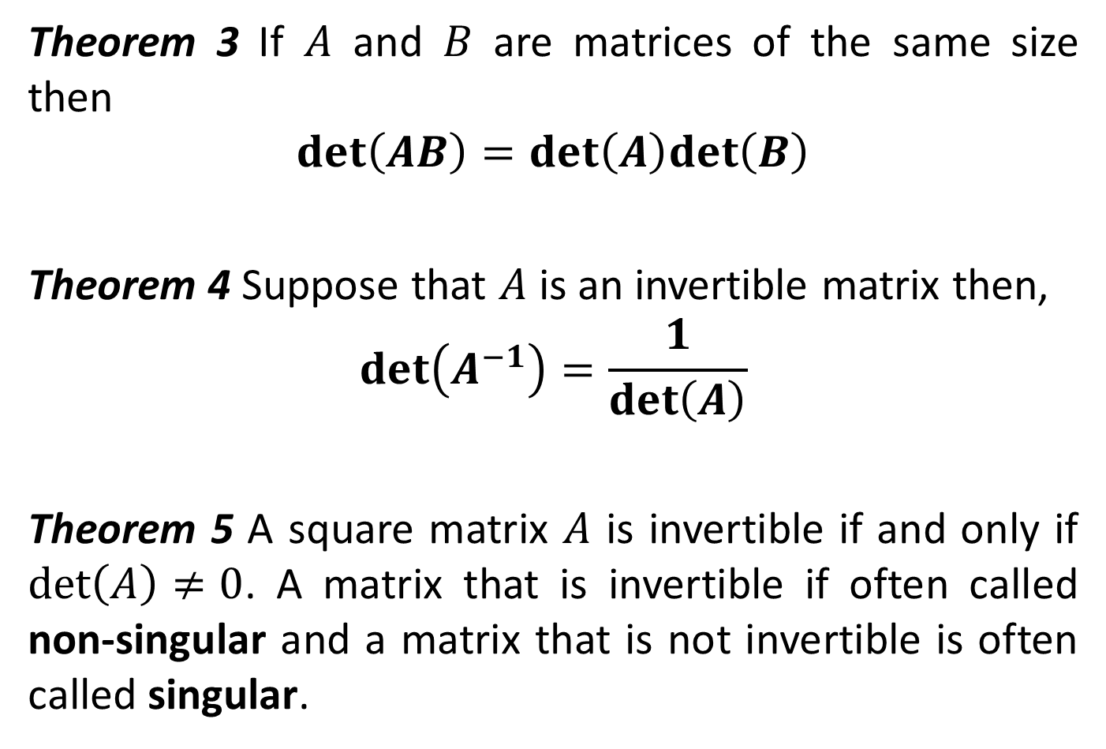
THEOREMS
Theorem 3 If $A$ and $B$ are matrices of the same size then
$$det\left(AB\right)=det\left(A\right)det\left(B\right)$$
Theorem 4 Suppose that $A$ is an invertible matrix then,
$$det\left(A^{−1}\right)=\frac{1}{det\left(A\right)}$$
Theorem 5 A square matrix $A$ is invertible if and only if $det\left(A\right)≠0$. A matrix that is invertible if often called non-singular and a matrix that is not invertible is often called singular.

Slide 25
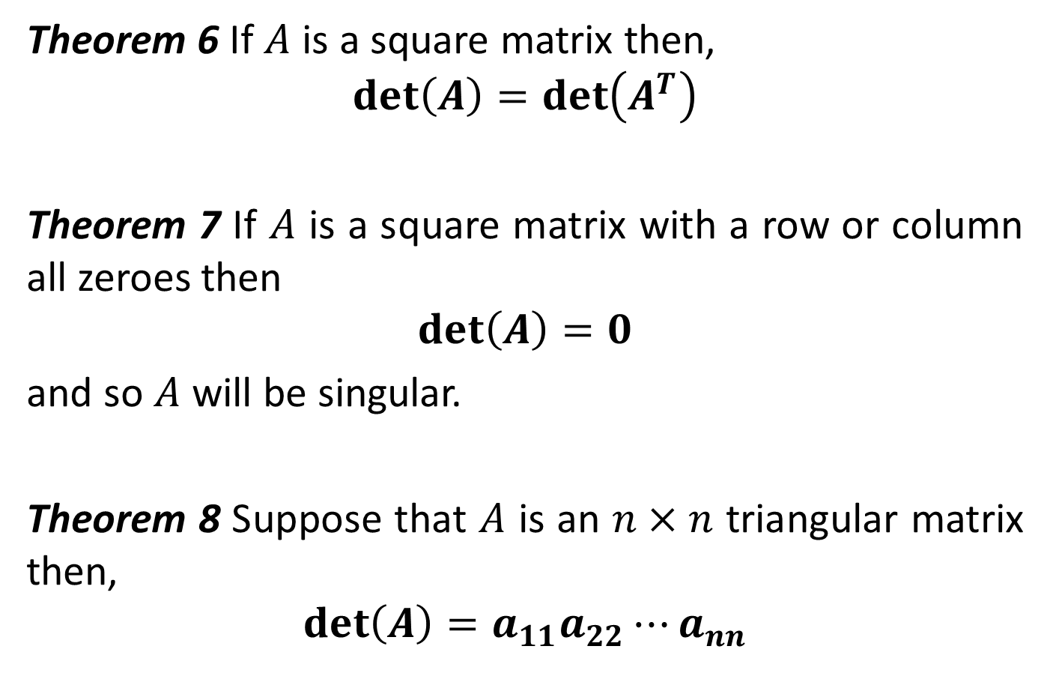
THEOREMS
Theorem 6 If $A$ is a square matrix then,
$$det\left(A\right)=det\left(A^{T}\right)$$
Theorem 7 If $A$ is a square matrix with a row or column all zeroes then
$$det\left(A\right)=0$$
and so $A$ will be singular.
Theorem 8 Suppose that $A$ is an $n×n$ triangular matrix then,
$$det\left(A\right)=a_{11}a_{22}⋯a_{nn}$$

Slide 26
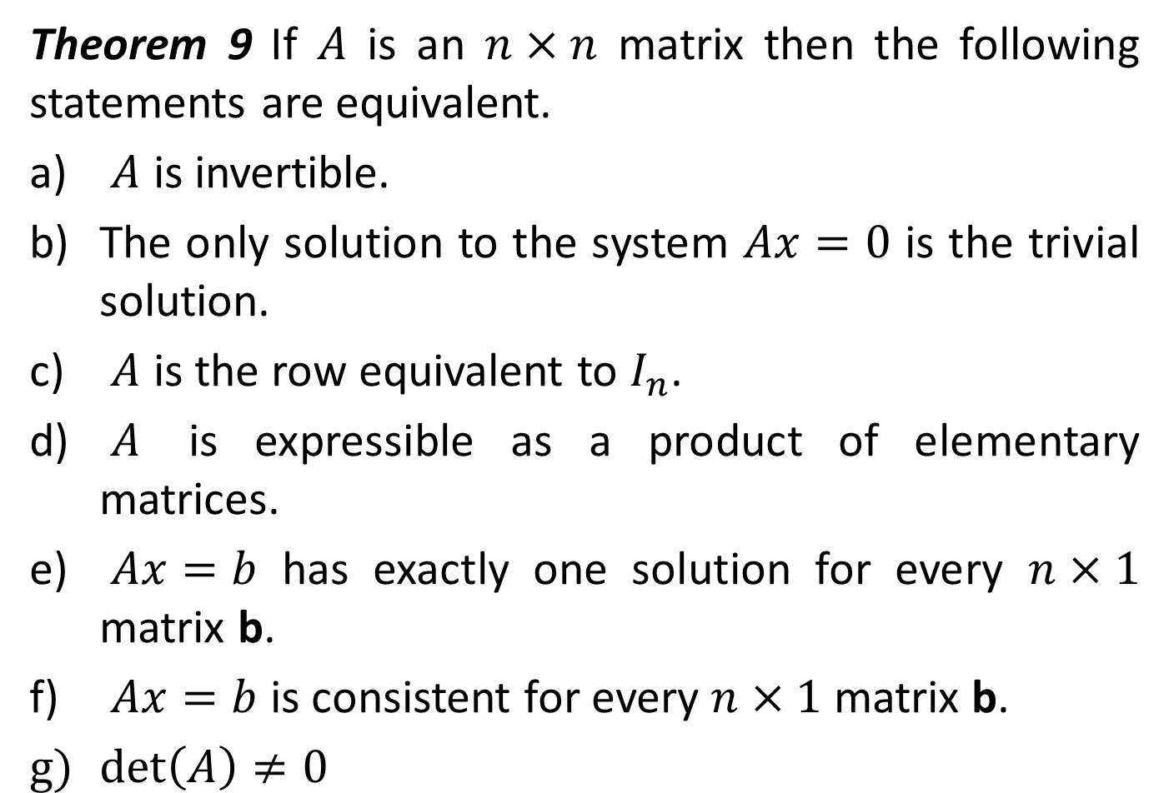
THEOREMS
Theorem 9 If $A$ is an $n×n$ matrix then the following statements are equivalent.
$A$ is invertible.
The only solution to the system $Ax=0$ is the trivial solution.
$A$ is the row equivalent to $I_{n}$.
$A$ is expressible as a product of elementary matrices.
$Ax=b$ has exactly one solution for every $n×1$ matrix b.
$Ax=b$ is consistent for every $n×1$ matrix b.
$det\left(A\right)≠0$

